Slide 1
Under the Hood of Hadoop Processing at OCLC Research
Code4lib 2014 • Raleigh, NC
Roy Tennant
Senior Program Officer

Slide 2
Apache Hadoop
A family of open source technologies for parallel processing:
Hadoop core, which implements the MapReduce algorithm
Hadoop Distributed File System (HDFS)
HBase – Hadoop Database
Pig – A high-level data-flow language
Etc.

Slide 3
MapReduce
“…a programming model for processing large data sets with a parallel, distributed algorithm on a cluster.” – Wikipedia
Two main parts implemented in separate programs:
Mapping – filtering and sorting
Reducing – merging and summarizing
Hadoop marshalls the servers, runs the tasks in parallel, manages I/O, & provides fault tolerance

Slide 4
Quick History
OCLC has been doing MapReduce processing on a cluster since 2005, thanks to Thom Hickey and Jenny Toves
In 2012, we moved to a much larger cluster using Hadoop and HBase
Our longstanding experience doing parallel processing made the transition fairly quick and easy

Slide 5
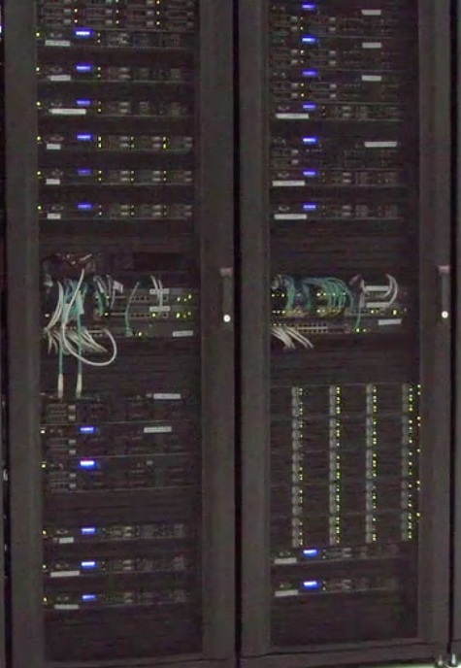
Meet “Gravel”
1 head node, 40 processing nodes
Per processing node:
Two AMD 2.6 Ghz processors
32 GB RAM
Three 2 TB drives
1 dual port 10Gb NIC
Several copies of WorldCat, both “native” and “enhanced”

Slide 6
Using Hadoop
Java Native
Can use any language you want if you use the “streaming” option
Streaming jobs require a lot of parameters, best kept in a shell script
Mappers and reducers don’t even need to be in the same language (mix and match!)

Slide 7
Using HDFS
The Hadoop Distributed File System (HDFS) takes care of distributing your data across the cluster
You can reference the data using a canonical address; for example: /path/to/data
There are also various standard file system commands open to you; for example, to test a script before running it against all the data: hadoop fs -cat /path/to/data/part-00001 | head | ./SCRIPT.py
Also, data written to disk is similarly distributed and accessible via HDFS commands; for example: hadoop fs -cat /path/to/output/* > data.txt

Slide 8
Using HBase
Useful for random access to data elements
We have dozens of tables, including the entirety of WorldCat
Individual records can be fetched by OCLC number

Slide 9
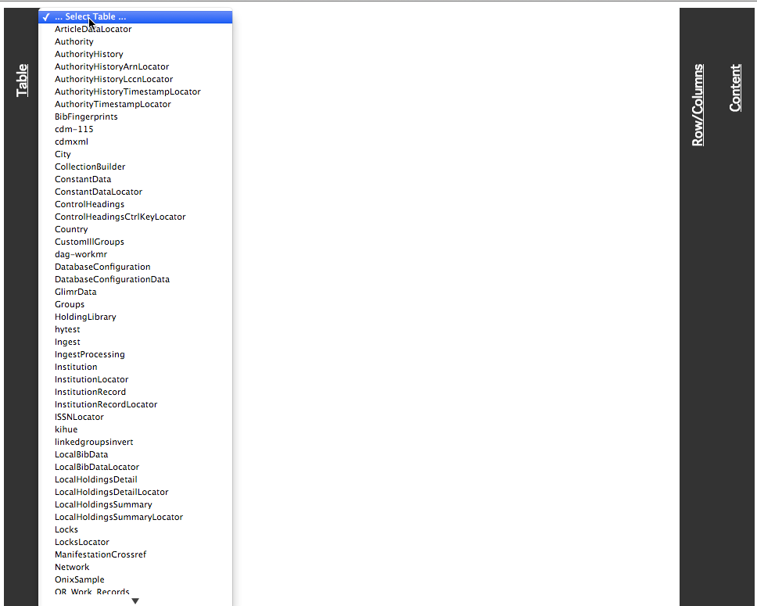
Browsing HBase
Our “HBase Explorer”

Slide 10
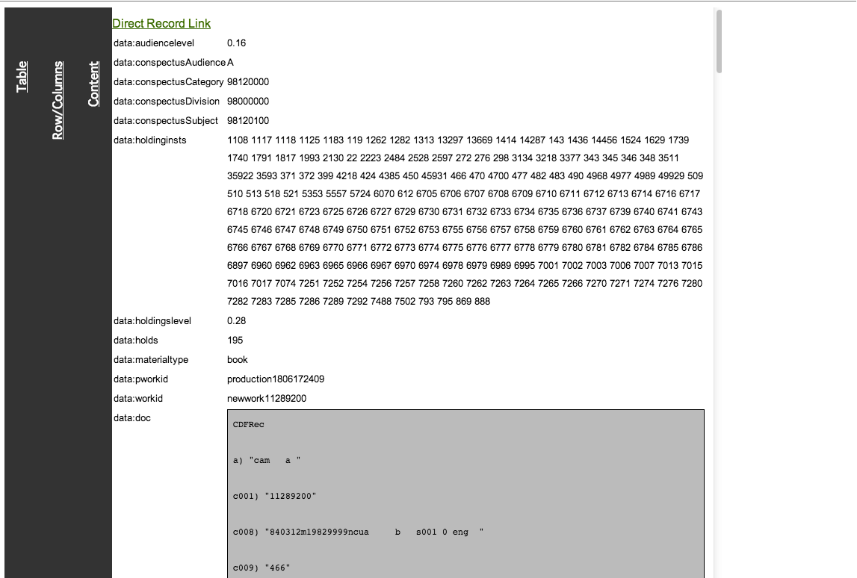
MARC Record

Slide 11
MapReduce Processing
Some jobs only have a “map” component
Examples:
Find all the WorldCat records with a 765 field
Find all the WorldCat records with the string “Tar Heels” anywhere in them
Find all the WorldCat records with the text “online” in the 856 $z
Output is written to disk in the Hadoop filesystem (HDFS)

Slide 12
Mapper Process Only
Shell
Script
Mapper
Data
HDFS

Slide 13
MapReduce Processing
Some also have a “reduce” component
Example:
Find all of the text strings in the 650 $a (map) and count them up (reduce)

Slide 14
Mapper and Reducer Process
Shell
Script
Mapper
Reducer
Data
Summarized
Data
HDFS

Slide 15
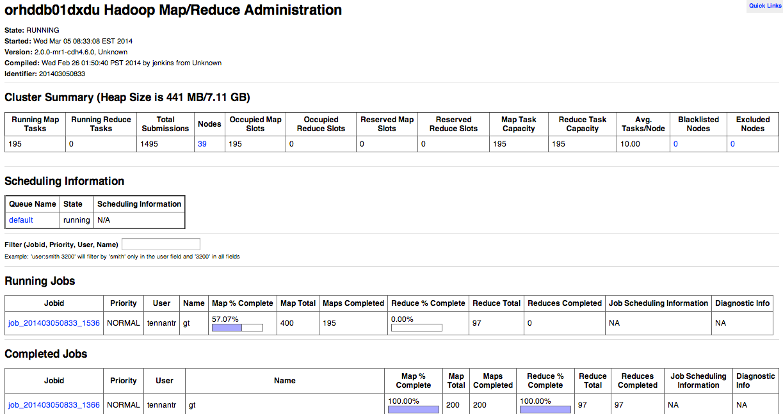
The JobTracker

Slide 16
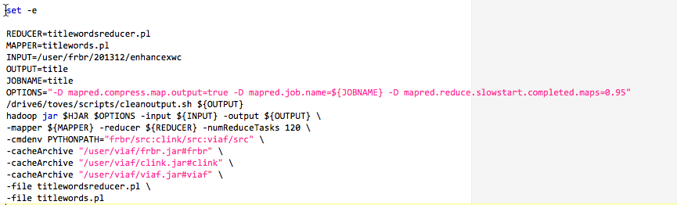
Sample Shell Script
Setup Variables
Remove earlier output
Call Hadoop with parameters
and files

Slide 17
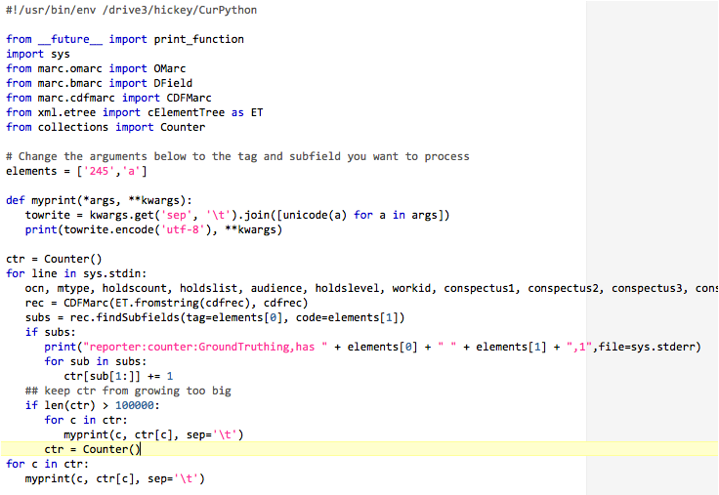
Sample Mapper
Sample Mapper

Slide 18
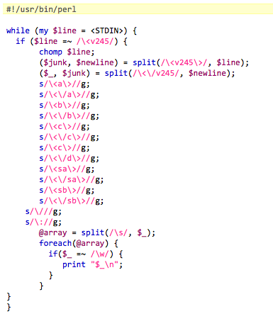
Sample Reducer
Sample Reducer

Slide 19
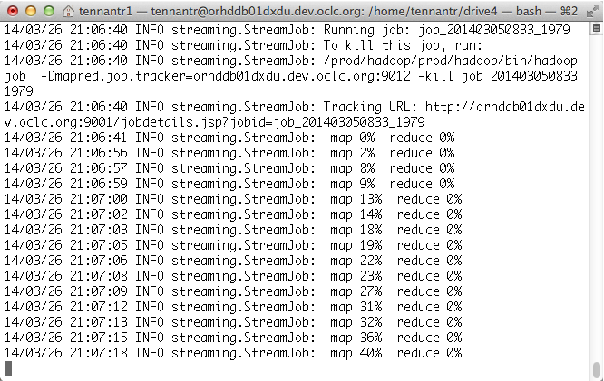
Running the Job
Shell screenshot

Slide 20
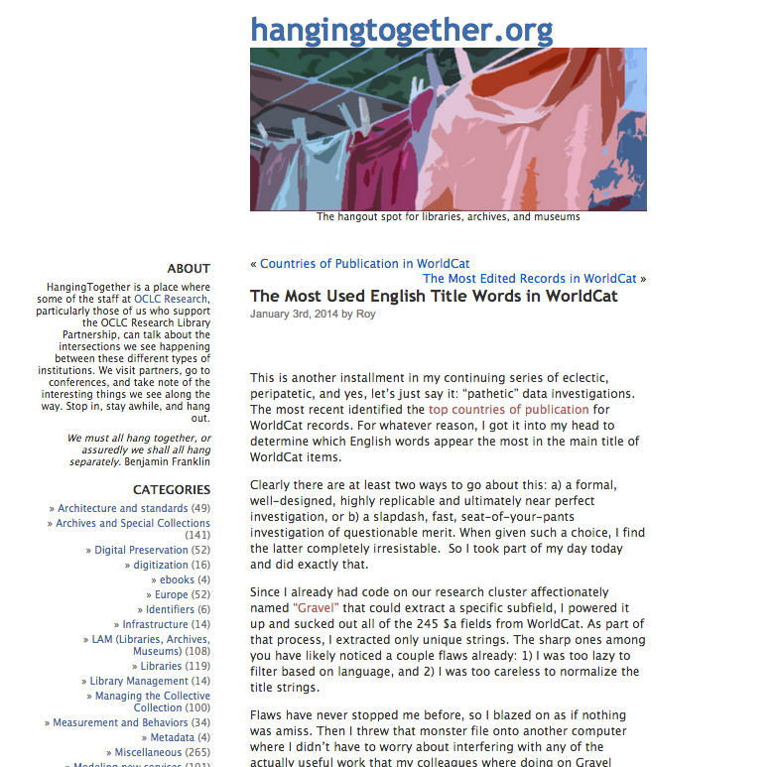
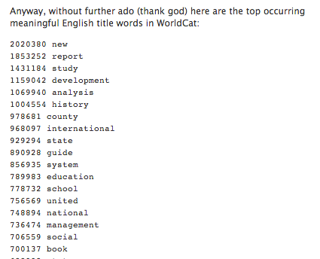
The Blog Post

Slide 21
The Press
When you are really, seriously, lucky.

Slide 22

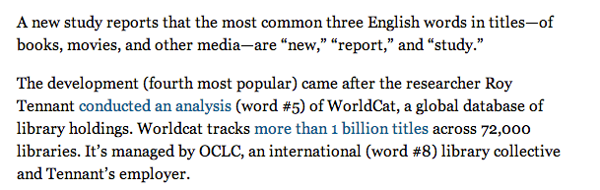

Slide 23
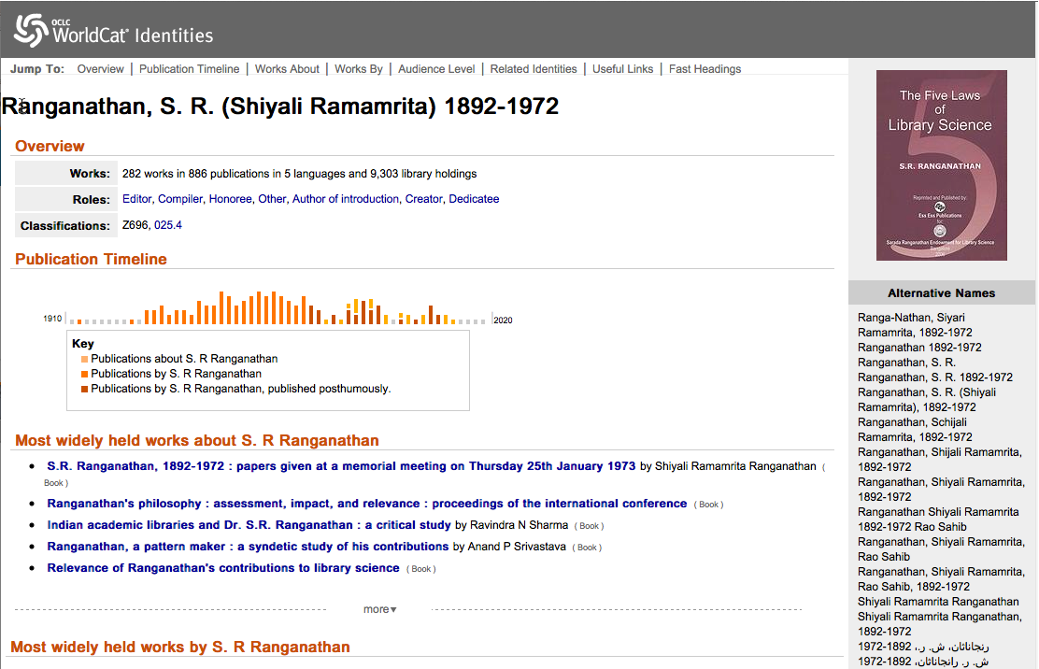
WorldCat Identities

Slide 24
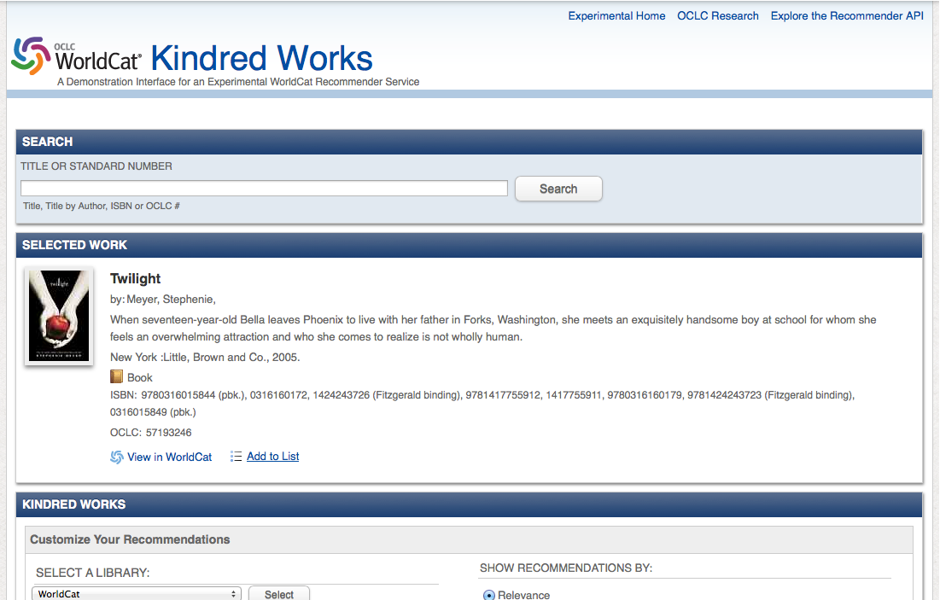
Kindred Works

Slide 25
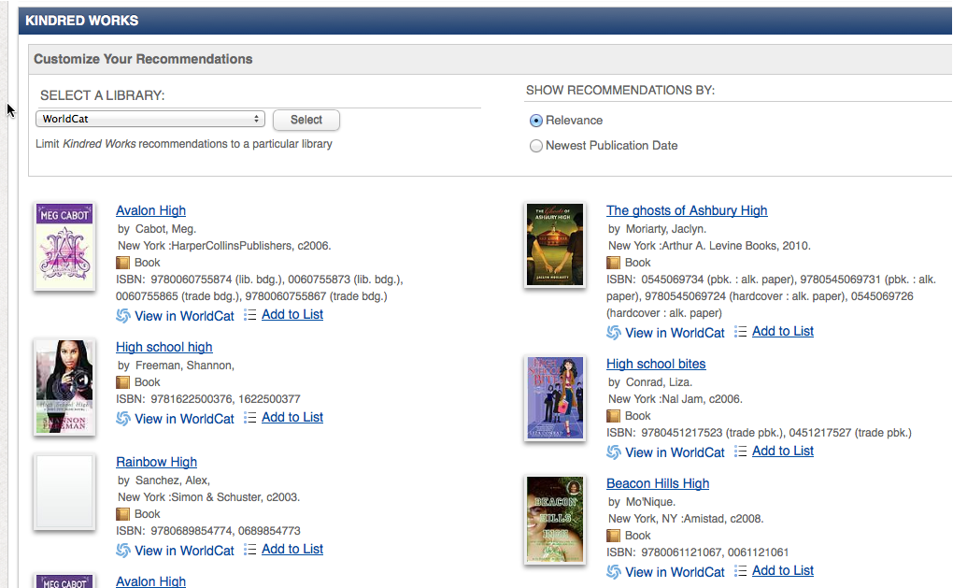

Slide 26
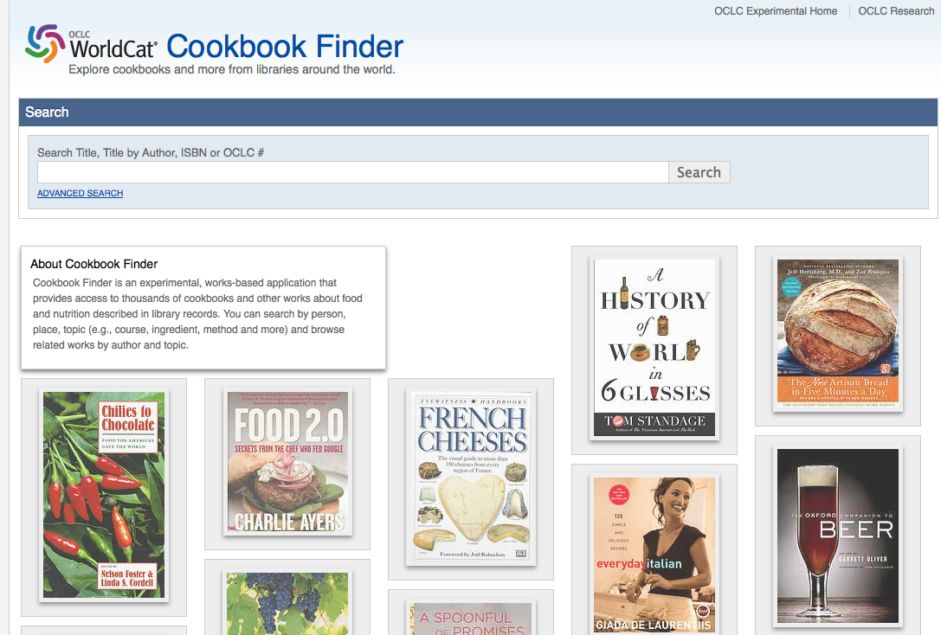
Cookbook Finder

Slide 27
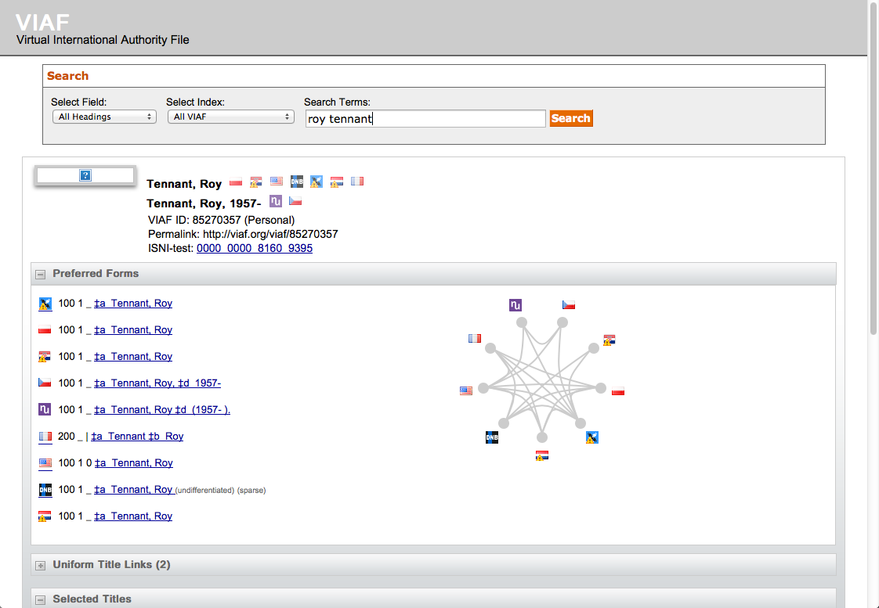
VIAF

Slide 28
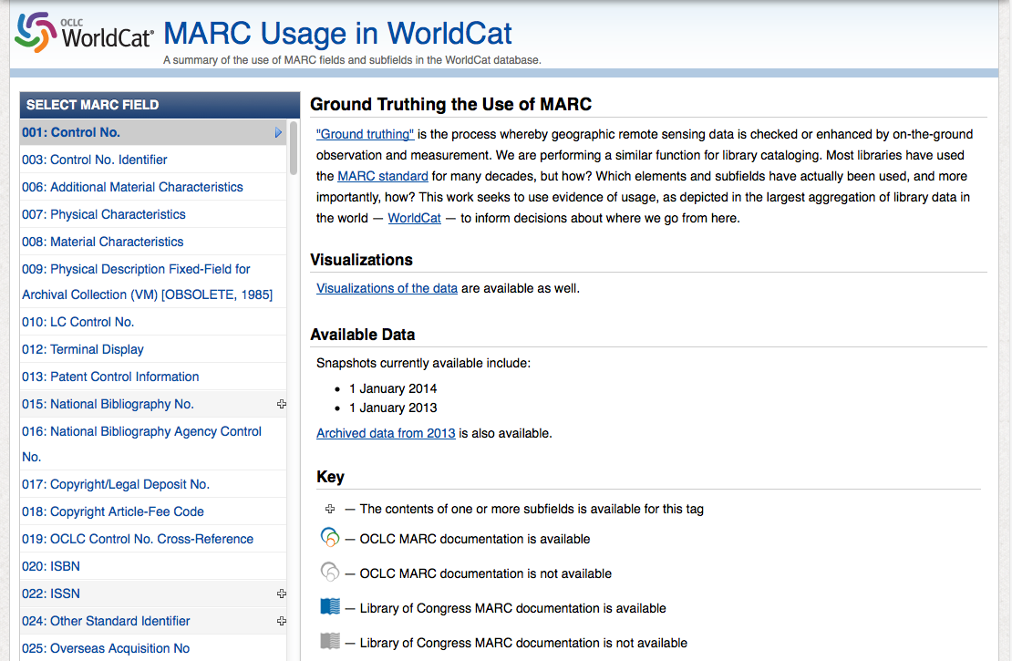
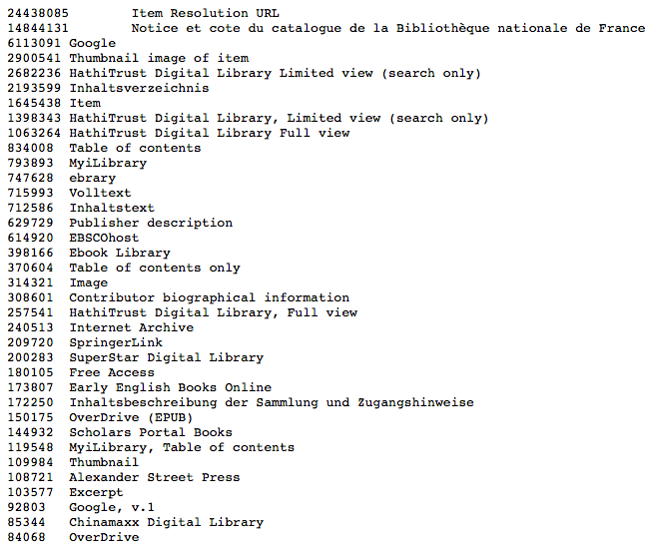
MARC Usage in WorldCat
Contents of the 856 $3 subfield

Slide 29
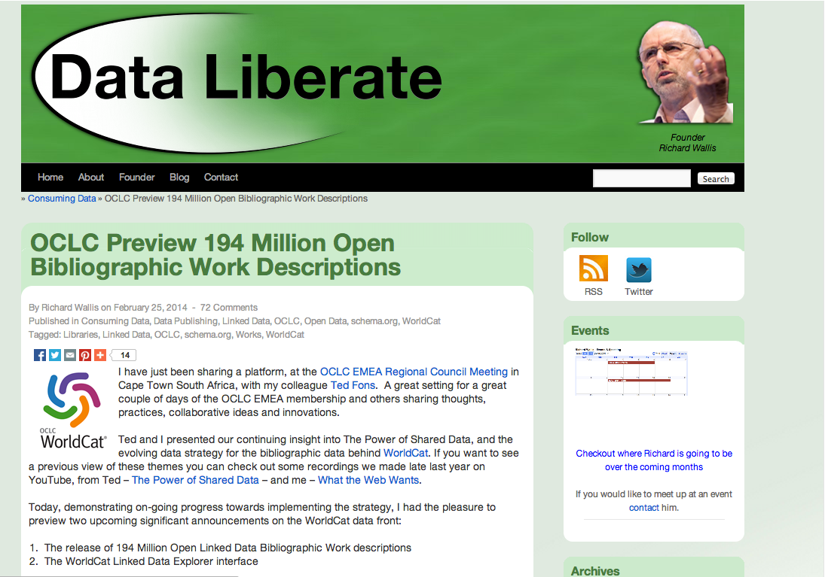
Work Records

Slide 30
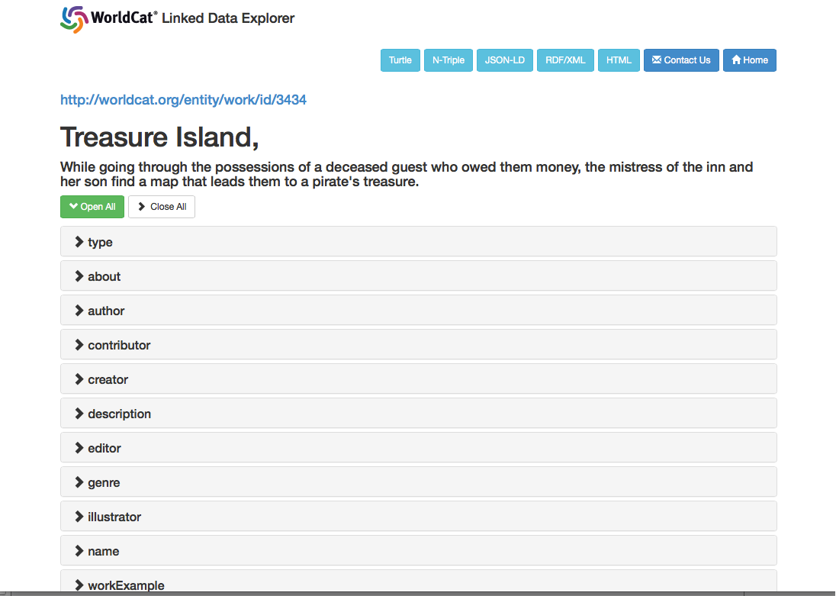
WorldCat Linked Data Explorer

Slide 31
Roy Tennant tennantr@oclc.org @rtennant facebook.com/roytennant roytennant.com

